Slide 1
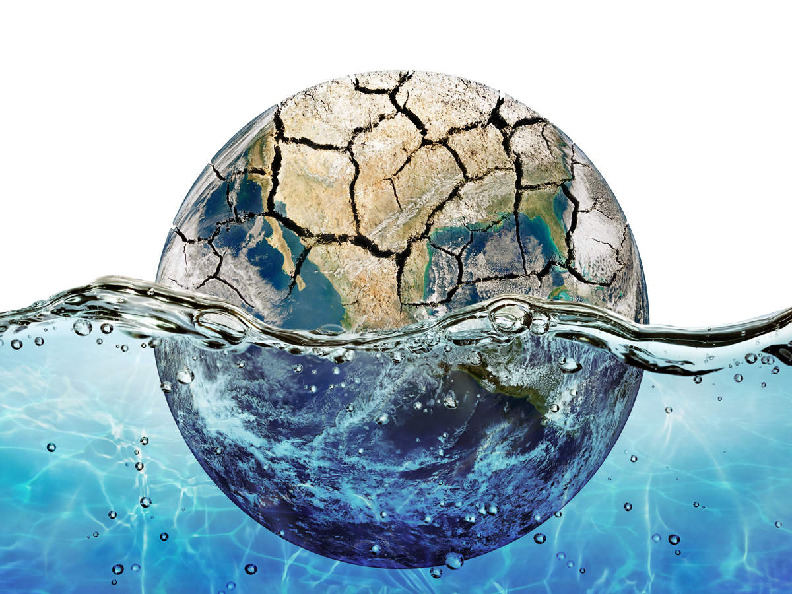
Global Warming
Nidhi Saini( T00671429)

Slide 2
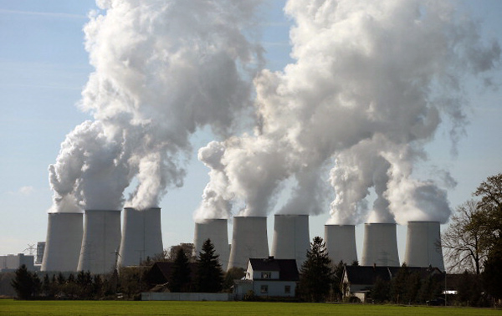
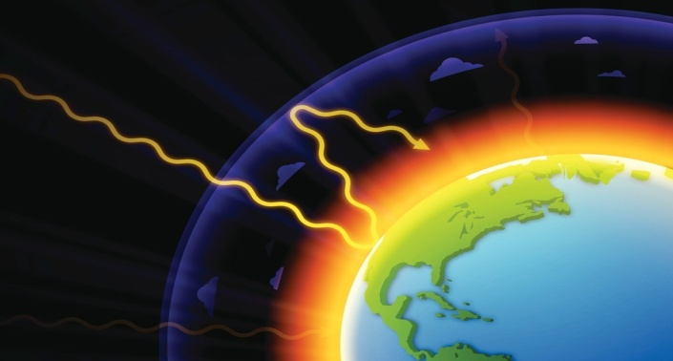
Activity 1- Questionnaire
Which of these contribute to current global warming?
Sun Spots
Carbon dioxide emissions.
Oxygen
Sun light
2) Which of the following is not a greenhouse gas?
Water vapor
Carbon dioxide
Methane
Ethane

Slide 3

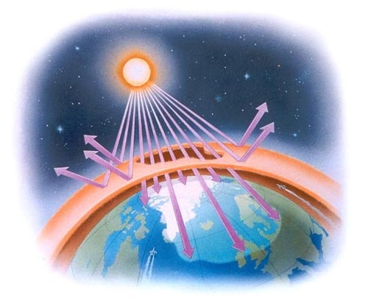
Climate change is heating the world evenly.
True
False
What is the importance of Ozone layer?
Protect earth from UV rays.
Provides oxygen to earth.

Slide 4

Activity 2- Watch the following video
https://youtu.be/4HdV6a3wI3g
After watching this video, tell me
What are the significant factors about global warming?

Slide 5
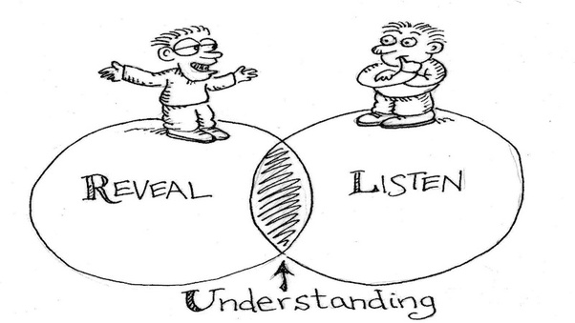
Activity 3- Create understanding
With your previous and current understanding, what are the significant factors of global warming according to you?

Slide 6

Activity 4- Discussion
Select one of the following topic and talk about that for 2 minutes.
Green house effect
Ozone layer depletion
Pollution
Also explain how it is related to global warming?

Slide 7



Activity 5-Peer Feedback
Rate this presentation in range of 1 to 5 stars
1-Highly Dislike
2- Dislike
3- Average
4- Good
5- Excellent
Suggestions-
Anything you wish to improve in this presentation
Any question you want to ask regarding this presentation

Slide 8


